Slide 1
Personal, Social, Health and Economic Education (PSHE)
at St Bede’s

Slide 2
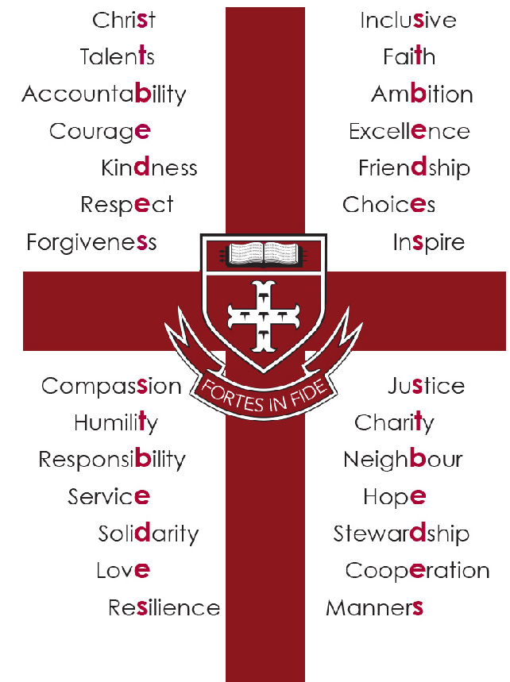

Slide 3
Our PSHE programme aims to prepare students for an adult life in which they can:
Receive accurate and relevant knowledge.
Experience opportunities to turn that knowledge into personal understanding.
Explore, clarify and if necessary, challenge their own and others’ values, attitudes, beliefs, rights and responsibilities.
Be aware of the skills and strategies they need in order to live healthy, safe, fulfilling, responsible and balanced lives.
Be successful learners who enjoy learning, make progress and achieve.
Be responsible citizens who make a positive contribution to society.
Develop positive values and a moral framework that will guide their decisions, judgements and behaviour; have the confidence and self-esteem to value themselves and others and respect for individual conscience and the skills to risk assess any situation in which they may find themselves.
Avoid being exploited or exploit others.
Communicate effectively by developing appropriate terminology.
Be aware of sources of help and acquire the skills and confidence to access confidential advice, and support if necessary.
Know how the law applies to their lifestyle choices.
The opportunity to explore their own ideas and develop their own personal voice in fun and engaging lessons
PSHE at St Bede’s:
What is the aim of PSHE?

Slide 4
PSHE Education in St Bede’s has four main elements within which students will be taught:
1. Health and Wellbeing
What is meant by a healthy lifestyle.
How to maintain physical, mental and emotional health and wellbeing.
How to manage risks to physical and emotional health and wellbeing.
Ways of keeping physically and emotionally safe.
About managing change, such as puberty, transition and loss.
How to make informed choices about health and wellbeing and to recognise sources of help with this.
How to respond in an emergency.
To identify different influences on health and wellbeing.

Slide 5
2. Relationships
How to develop and maintain a variety of healthy relationships, within a range of social/cultural contexts.
How to recognise and manage emotions within a range of relationships.
How to recognise risky or negative relationships including all forms of bullying and abuse.
How to respond to risky or negative relationships and ask for help.
How to respect equality and diversity in relationships.
3. Living in the wider world
About respect for self and others and the importance of responsible behaviours and actions.
About rights and responsibilities as members of families, other groups and ultimately as citizens.
About different groups and communities.
To respect equality and to be a productive member of a diverse community.
About the importance of respecting and protecting the environment.
About where money comes from, keeping it safe and the importance of managing it effectively.
How money plays an important part in people’s lives.
A basic understanding of enterprise.

Slide 6
4. Information Advice and Guidance
An understanding of the world of work.
An understanding of the career choices available.
About the choices process through Sixth Form College open days and taster sessions, college visits, mock interviews and visiting speakers.
About the options available to them for future education, training and employment.
How to access expert advice and where specialist information can be found.

Slide 7
Through the delivery of this programme students will be:
Developing confidence and responsibilities and making the most of their abilities.
Preparing to play an active role as citizens.
Developing healthy and safe lifestyles.
Developing good relationships and respecting the difference between people.
In following the framework for Citizenship our students will be taught:
Social and moral responsibility.
Community involvement.
Political literacy.

Slide 8
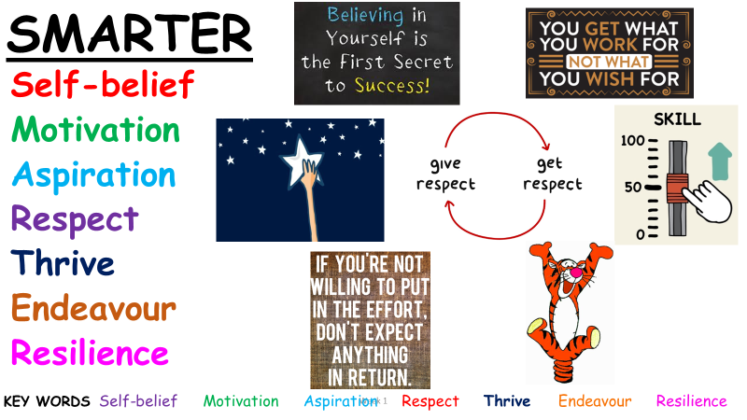
In short, we try to help our students to become SMARTER.
Each value is present in all our lessons. We believe such values will help to develop your child to be a responsible citizen within their community

Slide 9
We look forward to meeting you in September
St Bede’s PSHE Team

